Slide 1
Functions
Graphs and Sets in a 2 x 2 matrix

Slide 2
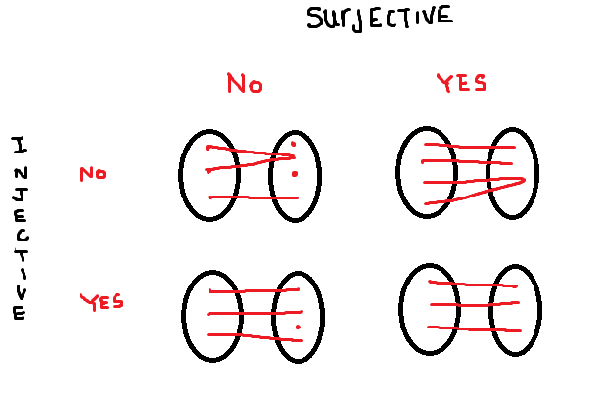

Slide 3
